Slide 1
Gateway Persistence Operational & Edge Cache Considerations
Jonathan Andrews
Solution Data Architect
(314) 388-8431 (Desk)
(314) 825-3629 (Cell)

Slide 2
RDM Data Granularity
Reference data granularity varies by domain
RDM Tables Identified with Gateway Impact | Granularity | GW Priority | MEC Rules | UI Picklist | UI Process | JESI Biller Map | JESI Order Process
Dwelling Type | Biller | 1 | Y |  | Y
**Dwelling Type Category | Biller | 1 | ?
Work Order Reason | Region | 1 |  | Y |  | Y
Work Order Cancel Reason | Region | 1 |  | Y |  | Y
Bad Words | Global | 1 |  |  | Y
Customer Type | Global | 2 |  |  | Y |  | Y
House Custom Field | Region | 2 | Y
Salutation Code | Global | 2 |  | Y |  | Y
Phone Type | Global | 2 |  | Y |  | Y
9xx Discount Code | SPA | 3 |  |  |  |  | Y
9xx Install Code | SPA | 3 |  |  |  |  | Y
9xx Package Code | SPA | 3 |  |  |  |  | Y
9xx Service Code | SPA | 3 |  |  |  |  | Y
Class Service Code Element | SPA | 3 |  |  |  |  | Y
Discount Code | SPA | 3 |  |  |  |  | Y
Install Time Code | Region | 3 |  |  |  |  | Y
VIP Flag | Biller | 3 | Y |  |  |  | Y
House Status | Global | 3 | Y
Product Type | Global | 3 | Y
Franchise Tax Area | Biller | 3 | Y |  |  |  | Y
Region | Biller | 3 | Y |  |  |  | Y
Division | Biller | 3 | Y |  |  |  | Y
Work Order Job Type | Region | 3 |  |  |  |  | Y
Work Order Status Code | Biller | 3 |  |  |  |  | Y
Line Of Business | Global | 3 | Y
Granularity of Reference Data
Data values presented to the application may vary based on the data domain and other criteria – most often location and process.
For application eligibility, data sourced and managed in the RDM solution can have one of 4 basic levels of location-based granularity:
Global
Biller-specific
Regional
Local
Similar, but often different, criteria also apply when reference data is translated for submittal to a specific biller.
In addition to location and process, the biller or instance of the biller itself may result in different values for consumption or translation.

Slide 3
Operational Data Requirements
Four Classes of Data Identified in the Gateway Requirements
The following classes of data have been identified in reviewing the Gateway requirements:
Write Once, Read Few (WORF)
(Logging, customer interaction)
Write Once, Read Many (WORM)
(User preferences)
Rolling List/Queue Managed
(last n accounts served, dashboard KPI values)
Transactional (prior to biller submittal)
(shopping cart)

Slide 4
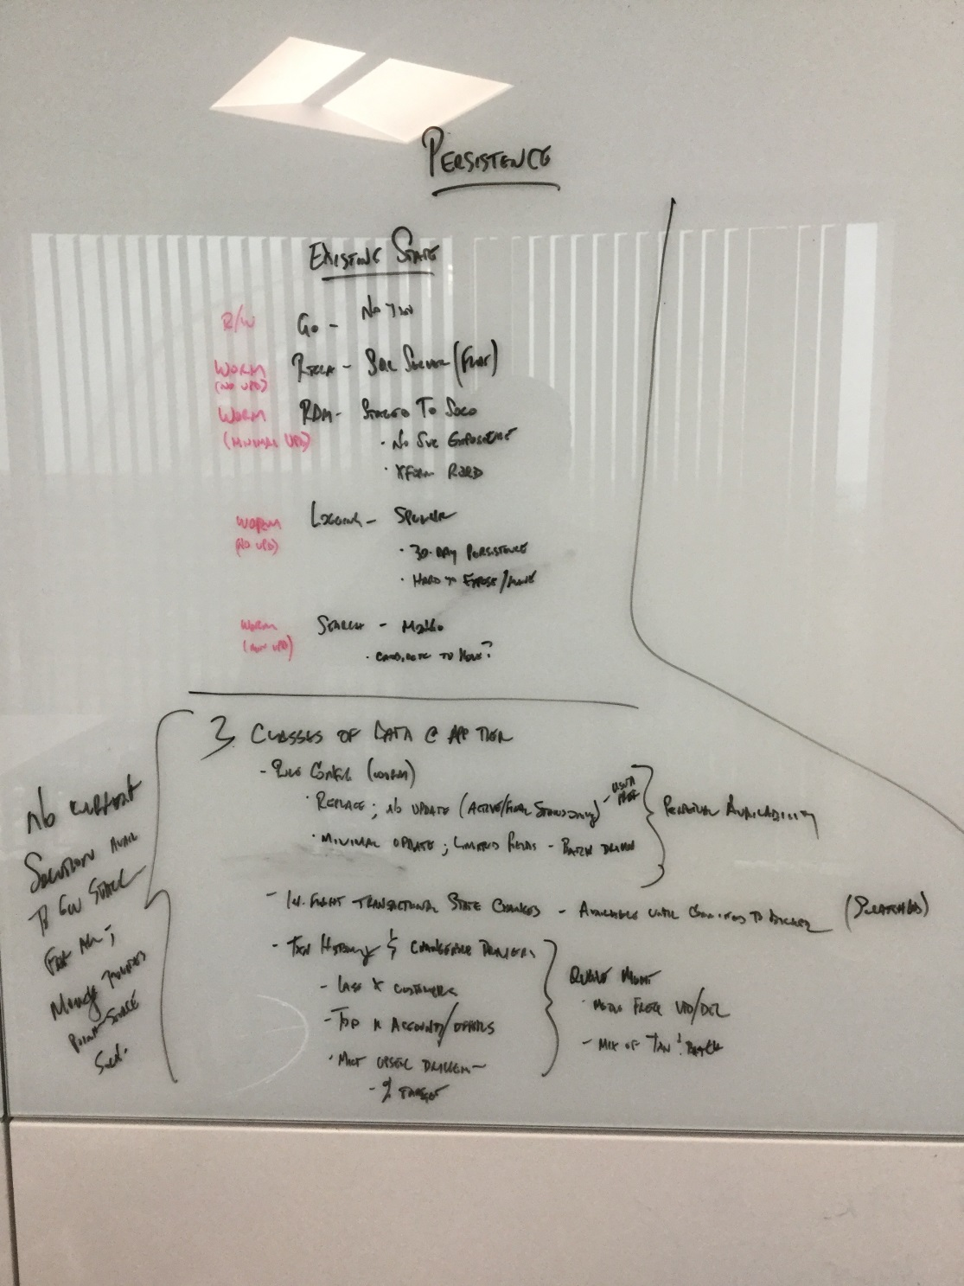
Data Persistence Categories
Current State
There are currently four classes or categories of data that have been identified as required to support the upcoming phases of the Gateway program:
Write Once, Read Few (WORF): Includes customer interaction data and transaction/event logs beyond the 30-day retention of Splunk.
Write Once, Read Many (WORM):
Category | Description & Usage | Storage | Retrieval
Write Once, read few (WORF)
Write Once, Read Many (WORM)
Rolling List/Queue Managed
Transaction state (prior to biller submit)

Slide 5
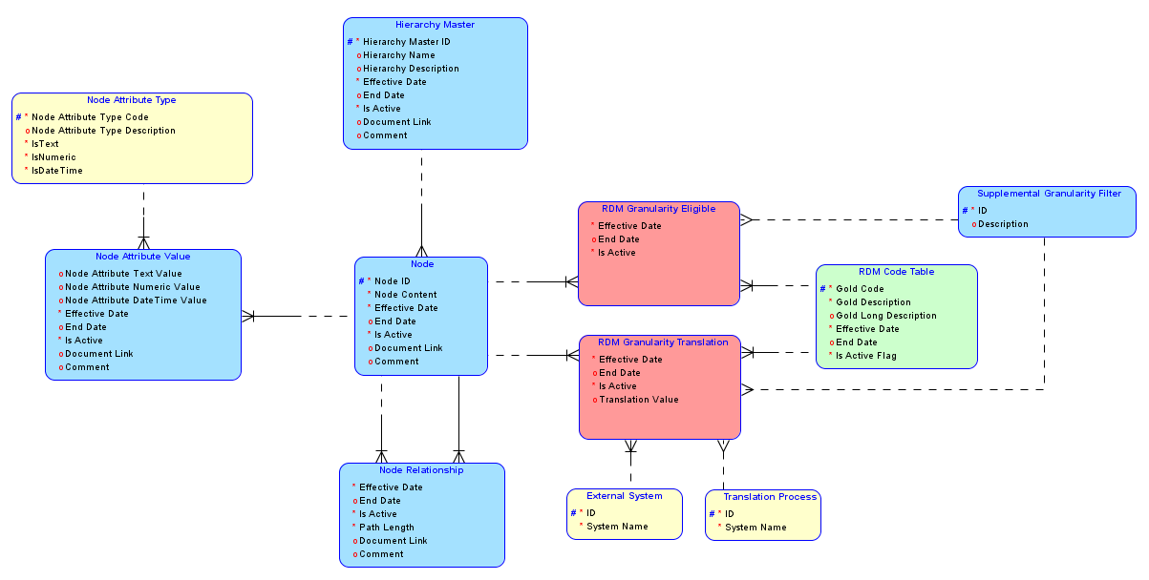
RDM Common Storage Pattern
Reference data can have different granularity for consumption and translation
A common model is used for persisting RDM data for both UI consumption and downstream translation.
The model supports granularity at any element in a defined hierarchy (in this case a location-based hierarchy) as well as a supplemental filter to support non-locational limitations (e.g. process-specific reason codes).
Granularity may differ between eligibility and translation; the same gold code may result in different translated values across different billers (or instances of billers), and these rules may differ from the locational or process-specific eligibility criteria.

Slide 6
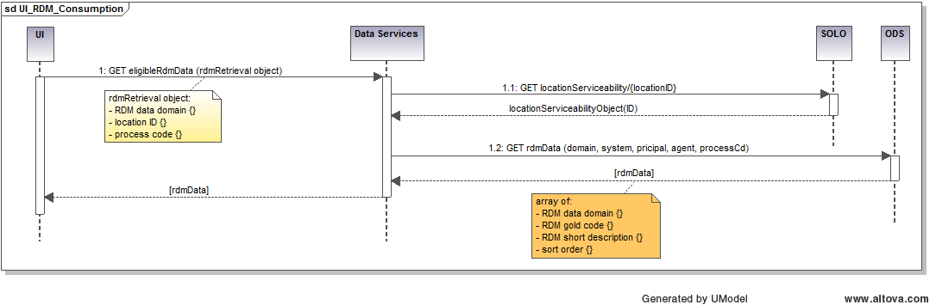
RDM Consumption by Application
Eligible RDM values can limited by location and process
Service-based consumption of RDM data supports eligibility limitations
This service model proposes a common approach whereby any (filtered) RDM domain can be retrieved using a standard call. The invocation identifies the domain to be retrieved and the base eligibility criteria (location and process). Specific details for location are retrieved (leveraging the existing locationServiceability call) and the specific array of eligible values are returned based on the specified criteria. In cases where no limitations are in effect on the RDM-based domain (e.g. BadWords), the location call is effective superfluous, but the broader nature of the limited eligibility makes the common pattern more desirable.
This approach assumes no persistence at the application level; RDM data is retrieved as needed based on application-based transactional criteria.

Slide 7
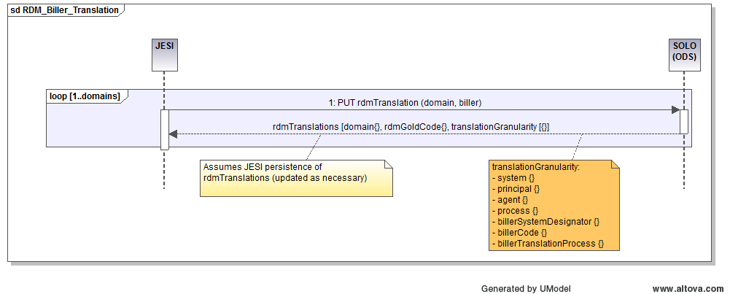
RDM Biller Isolation & Translation
RDM translation values can differ by location, process, and target biller system/instance
Translation rules for RDM data to biller-specific codes may differ from consumption rules
While similar in scope, the specific rules for translating RDM “Gold” codes to biller-specific values may differ from their consumption counterparts; consumption rules define eligibility while translation rules assume that the value submitted is eligible in the first place. Further, the translation may be simple (1:1 value translation) or more complex (1 gold code : many biller codes). For this reason, we support both direct value translation and derivation process-based translation.
This process assumes that JESI (or other rules-based translation engine) persists the translation rules (and related granularity) and updates only as values and rules change.

Slide 8
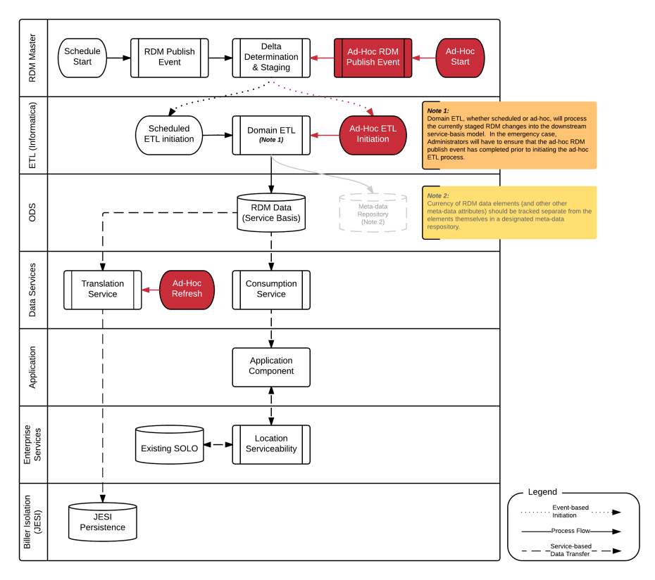
Phased Gateway Integration
Gateway Consumption Approach
Given some of the complexities and variability of the still-being-deployed RDM solution and the uncertain timelines of service availability form SOLO, Gateway will not make the initial release of Ordering functionality directly dependent on a full integration. Instead, Gateway Ordering (GO) will leverage RDM data in a phased approach, running parallel but not concurrent with the general GO release schedule; this allows for multiple independent releases of RDM-enabled GO components separate from the larger GO releases. Further, while GO will be an early adopter for RDM, other components of the larger Gateway program may take the lead in integrating specific RDM components.
Initial integration will focus on the more global of the RDM datasets, e.g.:
Bad Words
Customer Type
Salutation
Follow-on integration will address those domains with both UI and forward-translation impacts (e.g. work order reason), with those elements having reverse-translation impacts (e.g. dwelling type) being the last to be integrated.
High-Level Design Pattern (End-State)
It is the intention that there will be a single pattern for ingesting and consuming RDM data across the Gateway platform. This pattern will leverage both scheduled refreshes of the RDM data and ad-hoc refresh capability to support emergency releases. Data will be made available to the applications through REST-based data service(s), presenting the requested RDM data domain as constrained by the requesting parameters (location, process, effective date, etc.).

Slide 9
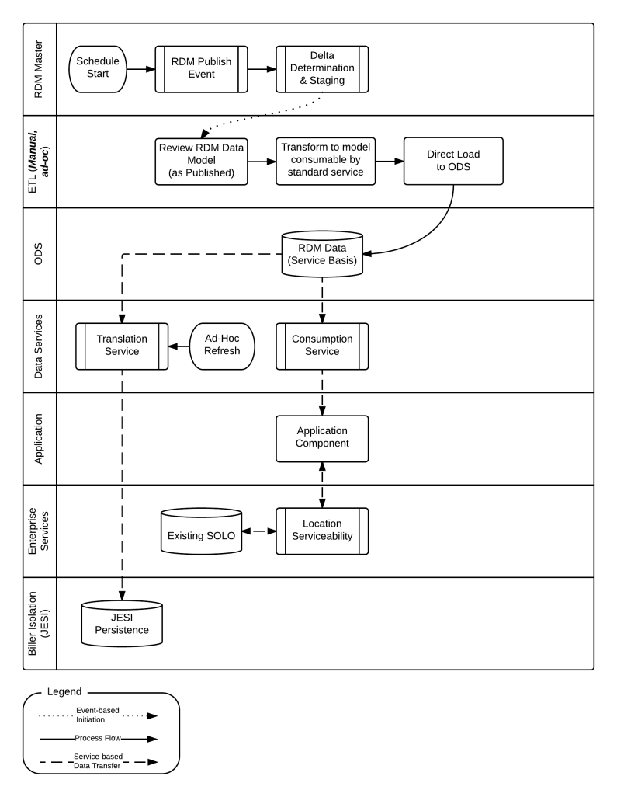
Initial/Interim Approach
Many moving pieces to build and connect
Initial Build-Out
The RDM Implementation team continues their rollout to production. While leveraging a standard model in its implementation, the model is not directly conducive to be used as the source for a REST service-based (or microservice-based) application integration approach. Any direct consumption approach will require some level of transformation of the RDM model as deployed.
While Application Architecture has a comprehensive understanding of how the data will be used (both for application consumption and downstream translations) and more than a passing understanding of the RDM solution as deployed, there are nuances to specific RDM-based data domains that may require tweaks to a detailed service implementation design. For this reason it is the recommendation that (in addition to beginning with the least complex data domains as previously discussed) the initial translation to a model upon which application services could easily be deployed.
This approach vets the high-level design and begins the build-out of required structural components:
ODS containing RDM Data in service-consumable model
Data services, including both consumption and forward-translation services
Design patterns for domain-specific data transformations (and validation routines for future automated ETL processes)
The key process difference here is the lack of automation to track RDM changes; this will require closer communication between the RDM and Gateway teams until this automated process can be instantiated.

Slide 10
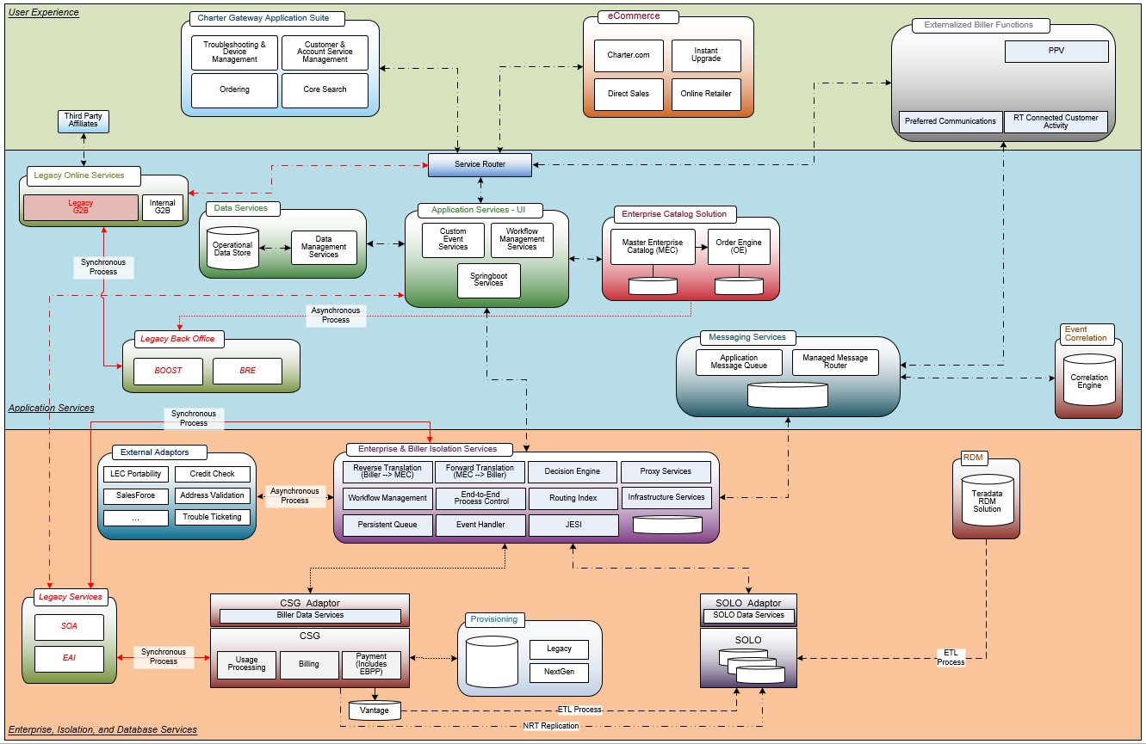
Integrated Architecture – Phase 1
Specific data services built against a dedicated Gateway Operational Data Store
Gateway Operations Data Store
The existing SOLO data store was not designed to support the operational business transactions; it was more designed as a reporting solution against transactional data after-the-fact. If Charter is to truly move toward a biller-isolated operational strategy, it will rapidly recognize the need for a Charter-specific canonical model that directly supports business transactions across all sales channels.
Gateway applications today are built leveraging levels of service architecture that provide little incremental benefit to the overall solution; many serve to pass-through data with little change.
Proposed is an architecture whereby Charter applications interact much more closely with an operational data store and canonical model. This data store provides the platform for integrating the Gateway applications with RDM data. Initially, this integration is through manual transformation and replication, as the development teams finalize the target model(s) and automation process.

Slide 11
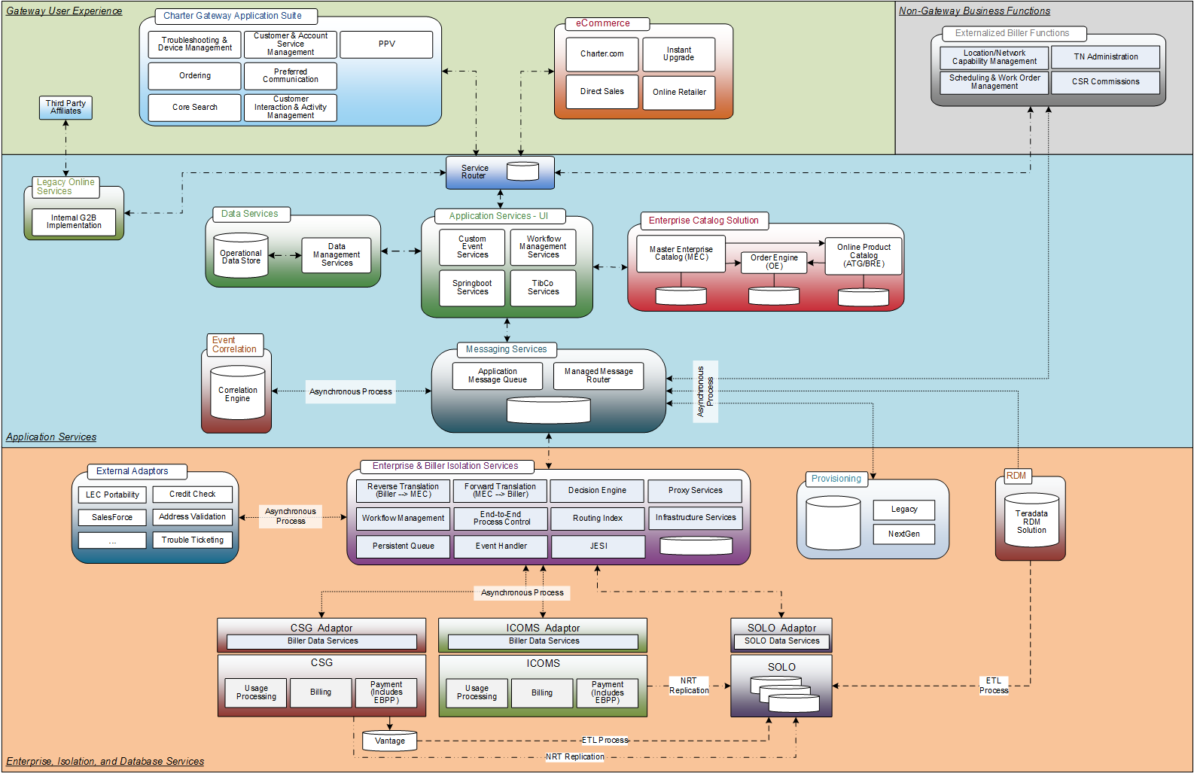
Integrated Architecture – End State
Event-based architecture leveraging asynchronous message bus provides robust application flow control and cross-application orchestration
Event-Based Architecture
Incorporating elements of event-based and micro-service architecture into the landscape will make Charter’s applications more flexible and robust.
To support evolving to an event-based architecture, Charter Applications Architecture will introduce a message queue with intelligent routing capabilities. This will leverage the Netflix Open Source Stack given its proven scalability and robust fault tolerance.
Charter Application Architecture will work closely with the design and development teams to fully integrate and leverage the canonical model (extending where necessary) and message infrastructure for an optimal solution on a readily extensible platform.

Slide 12
Supplemental Materials

Slide 13

End State Flow Diagram
Return to Doc

Slide 14
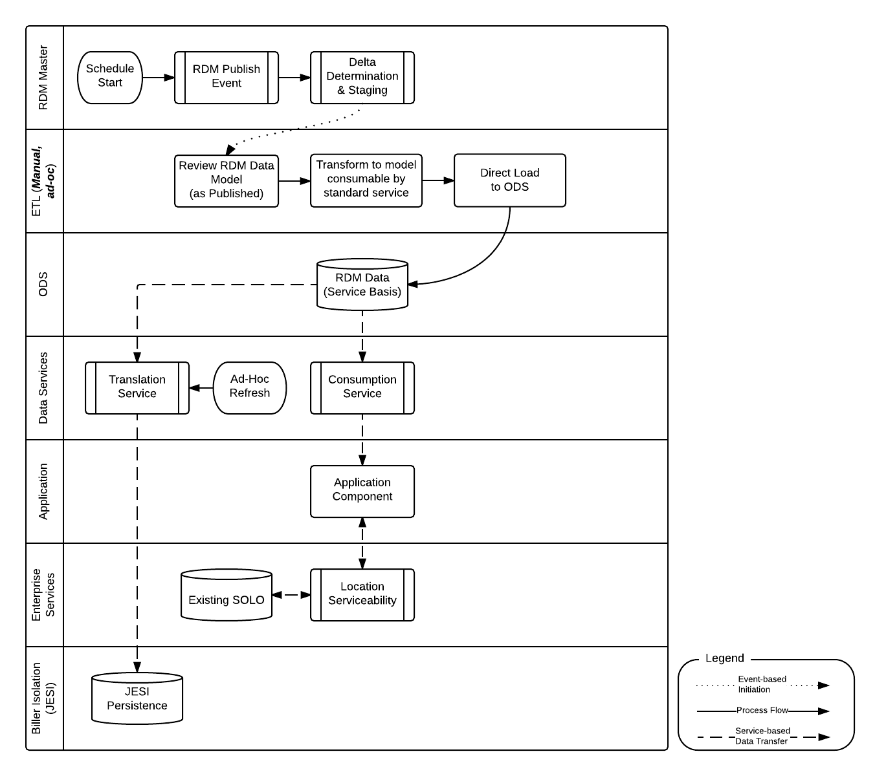
Initial/Interim State Flow Diagram
Return to Doc

Slide 15
Gateway Operational Architecture, R2+
Return to Doc

Slide 16
Gateway Operational Architecture, R3+
Return to Doc

Slide 17
Status Quo
General
Levels of service architecture that provide little incremental benefit to overall solution; merely serve as pass-through
Fully synchronous
SOLO
Built on Cable Labs industry common model and extended with CSG-specific elements
Populated sub-daily from CSG Vantage
Leverages CSG instance-specific IDs for establishing and maintaining relationships
Doesn’t support data versioning today; last update wins
Difficult to query directly
Inferred data relationships do not always exist where logical
Business-interaction centric
Object models built on SOLO model are cumbersome
Can’t return Party and Account together due to size of each; requires distinct but orchestrated calls
Large models cause limitations on scope of returned data sets
Hibernate deployment introduces longer development and deployment times
EAI (and EAI+)
Designed and deployed against CSG API (SLBOS)
Leverage CGS IDs for uniqueness
Supports CSG pricing model today; questions surround ease of extensibility to ICOMS matrix-based pricing model
MEC and Biller Isolation
Questions regarding System of Record/System of Maintenance for Pricing
Questions surrounding coordination and synchronization between MEC and biller systems (offers, prices, etc.)
JESI-routine design and development controlled with limited Charter oversight (contractor/vendor-driven)
RDM Integration
Differences in understanding of role of RDM in overall solution; what constitutes integration?
SOLO is populated directly from CSG-Vantage; recoding to leverage RDM codes is non-trivial exercise.
Operational procedures (data governance, out-of-band deployments, etc.) not addressed in initial rollout
Notes:
Seasonal resume - just happens
Partially complete requires splitting jobs; deferred (remove from slide)
Provisioning - CSG & beyond, but there are settings in the order that impact provisioning. Assumption - we will use default values (CSR doesn't change) that have their own provisioning.
Transfers - do a single design that supports cross-biller?
Add in RTCSR (TN Portability changes)?
Order Versioning in SOLO - required for pending orders/IPO
Workflow management - deviation/out of process changes. Now don't have any way to go backward from scheduling
New address scrubber? Auto-scrubbing functionality (google-like search)
Biller first assumption
TN Administration extract - Ryan Barnes & Ginsberg

Slide 18
Blue-Sky Considerations
What’s needed to address some of the shortcomings of the existing solution?
Charter-specific canonical model that directly supports business transactions (all sales channels)
Versioning of transaction data
Integration with RDM solution; refreshable on ad-hoc basis
Consolidation of data access services
Application-based data persistence
In-memory cache to support reference data for consumption
Disk-based cache to support storage and retrieval of transaction-based data
Support for asynchronous transactions
Detailed logging and metrics at all levels
User Experience changes – migrate away from business as usual (“the way we work in ACSR today”) to the post-merger operation (“the way Charter wants to do business tomorrow”)
ICOMS functional integration
Best of TW business process integration

